Slide 1
SmartPlant 3D Programming I
Ramon Him
Rhim@ingr.com
August 2006

Slide 2
What will be covered in this training?
Overview:
Understanding the SP3D data Model
Introduction of the Schema Browser Tool
Naming Rules
Attribute Helper services
Relation Helper services
Symbol Definition for Route Objects
SmartPlant 3D Tools
  Symbol Wizard
  Reference Tool
Symbol Helper Components/Services
Geometry Factories
Symbol Deployment and Guidelines
  Changing the symbol definition
  Synchronization between model & catalog
Debugging your code

Slide 3
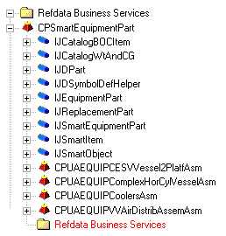
SmartPlant 3D Data Model
Use the Schema Browser Tool to view the data model
Model Database
Catalog Database
Catalog Schema Database

Slide 4
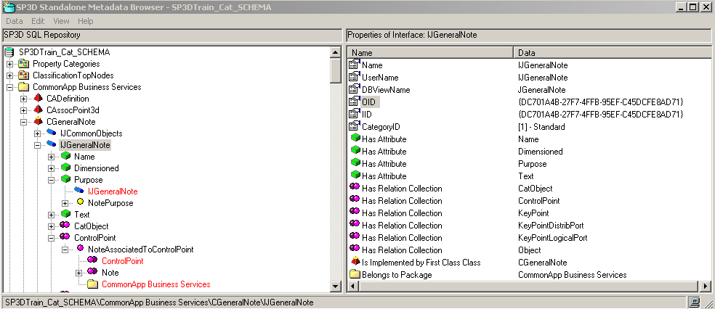
Schema Browser Tool
Package
Metadata Object highlighted in the treeview or found by Find
Class
Interface
Property
Metadata Object Properties
Codelist
Relation Collection
Metadata Object Relationship
Relation
Ancestor

Slide 5
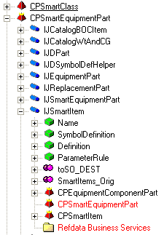
Schema Browser Tool
A regular folder represents a package i.e. metadata of a service
A red pyramid represents a class. A red pyramid overlayed by a yellow crown represents a first class, i.e. a class that is a leaf in the BOC (Business Objects Classification) hierarchy
A green box represents a property.

Slide 6
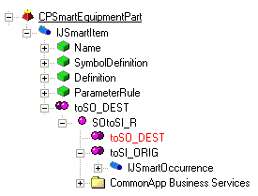
Schema Browser Tool
Relationships
Relations are binary
A relation is between two and only two entities.
These entities are known as origin and destination of the relation
Example: SOtoSI relationship (There is a relation between smart occurrence and the smart item).
Destination
Relation
Origin

Slide 7

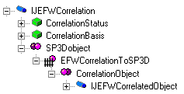

Schema Browser Tool
A single magenta sphere represents a relationship. A single magenta sphere overlayed by a fence represents a private relationship.
Double magenta/purple spheres represent a relationship collection (a role).
An orange diamond represents an Edge, i.e a virtual relationship that "bridges" several relationships.
Double Orange diamonds represent an edge collection (a role).

Slide 8
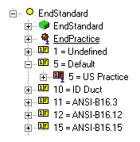
Schema Browser Tool
A yellow sphere represents a codelist table.
A yellow domino with a number and a letter represents a codelist value.
A brown sphere overlayed by a blue human outline represents a parent codelist table.
A brown domino with a number and a letter overlayed by a blue human outline represents a parent codelist value.

Slide 9
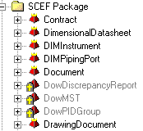
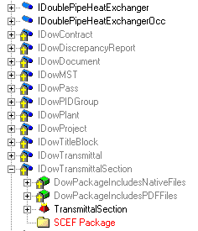
Schema Browser Tool
Any icon overlayed by a tombstone represents a metadata object marked as deleted.

Slide 10
Schema Browser Tool
Under View -> Units of measure, you can see the units for each Unit type. For each Unit type, the blue unit represents the (SI) Database unit (DBU). Right click on any unit allow you to convert a value in DBU.
Under view -> Enumerations, you can know the different values of all the enumerations used by the metadata.
If you re-open often the same schema, you should choose "Auto open open DB dialog" in Options.
You can switch from displaying metadata object internal Names (System) to Usernames (User).

Slide 11
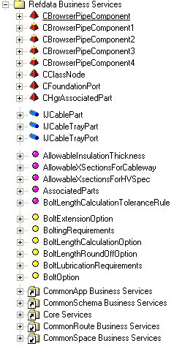
Reference Data Model
Package
Class Business Objects
Interface
Relation
Codelist
Dependencies
Dependencies

Slide 12
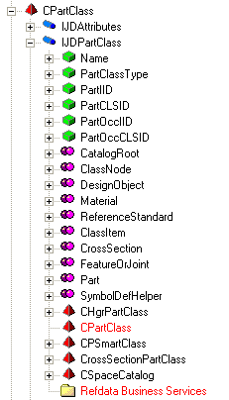
Part Class Entity Data Model
Part Classes
Class
Interface

Slide 13
SQL Basics
Relational Databases are made of:
  Tables
    Where the data are persisted. Tables are made of columns (the properties) and rows (the occurrences or records).
  Views
    A predefined selection of a subset (or a superset) of columns and/or a subset of rows from one or more table(s).
  Relations
    They are not “hard-coded”, they are established on request by performing a join (usually equality of values of identical columns of different tables).

Slide 14
SQL Basics
Query Language
SELECT t1.col1, t2.col2
FROM t1 JOIN t2 ON (t1.col2 = t2.col4)
WHERE t1.col1>200
ORDER by t1.col1
  SELECT: means list, return, give me…
    List of columns from which data must to be listed. It defines a subset of the columns to be returned. * means All.
  FROM: defines the view (or starting point view) from which the columns and data must be listed. If a join is specified, a superset of the columns of the view is accessible.
    JOIN: the way to navigate relations, defines a second view to be joined.
      ON: specifies the condition of the join.
  WHERE: criteria to establish a filter (subset) of the rows to be listed
  ORDER BY: sorting criteria

Slide 15
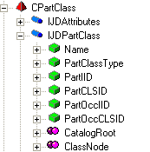
Part Class Entity Data Model
Part Classes
select count(*),
PartClassType
from JDPartClass
group by PartClassType
select * from
JDPartClass
where PartClassType = 'EquipmentAssemblyClass'
Notes:
select count(*),
PartClassType
from JDPartClass
group by PartClassType
select * from
JDPartClass
where PartClassType = 'EquipmentAssemblyClass'

Slide 16
Equipment Reference Entity Data Model
CPSmartEquipmentPart
Package
Class
Interface
Notes:
select
* from
JSmartEquipmentPart x1
join JSmartItem x2 on x2.oid = x1.oid
join JDSymbolDefHelper x3 on x3.oid = x1.oid
join JDReplacementPart x4 on x4.oid = x1.oid
join JEquipmentPart x5 on x5.oid = x1.oid
join JDPart x6 on x6.oid = x1.oid

Slide 17
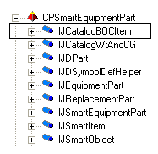
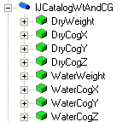
Equipment Reference Entity Data Model
Common interfaces
The IJCatalogBOCItem interface allows the Business Object to participate in the Catalog BOC (Business Objects Classification) hierarchy.
The IJCatalogWtAndCG interface provides methods to get the center of gravity and properties relating to an object's weight and center of gravity.

Slide 18
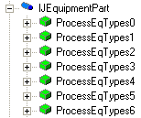

Equipment Reference Entity Data Model
Common interfaces
The IJEquipmentPart interface provides code-listed properties to describe the Equipment Classification Type for all equipment parts.
The IJReplacementPart interface provides a property to get the equipment part number when the mirror behavior option is set to Replacement required.

Slide 19
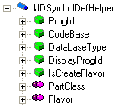
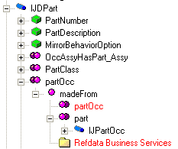
Equipment Reference Entity Data Model
Common interfaces
The IJDSymbolDefHelper interface provides methods to assists in the definition of the cached symbol and properties relating to the symbol definition.
The IJDPart interface is a generic interface that permits obtaining information about a part or part occurrence.

Slide 20
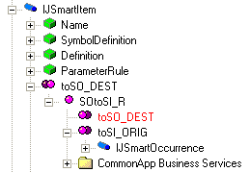
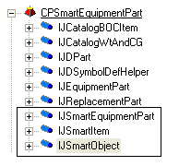
Equipment Reference Entity Data Model
Common interfaces
The IJSmartItem interface provides properties relating to the smart item and permits obtaining information about a smart item or smart occurrence.
The IJSmartObject interface permits obtaining information about a smart class.
The JSmartEquipmentPart interface provides methods to obtain information about Smart Equipment.

Slide 21



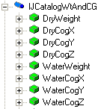
Equipment Reference Entity Data Model
Common Properties
Custom Properties
The Custom Interfaces sheet defines the customized user interfaces and attributes (properties) for the part classes.
Notes:
10
6

Slide 22
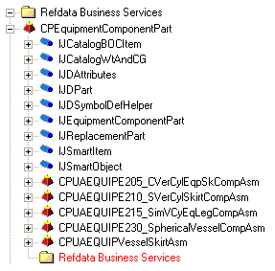
Equipment Reference Entity Data Model
CPEquipmentComponentPart
Class
Interface
Notes:
select
* from
JEquipmentComponentPart x1
join JSmartItem x2 on x2.oid = x1.oid
join JDSymbolDefHelper x3 on x3.oid = x1.oid
join JDReplacementPart x4 on x4.oid = x1.oid
join JDPart x6 on x6.oid = x1.oid

Slide 23
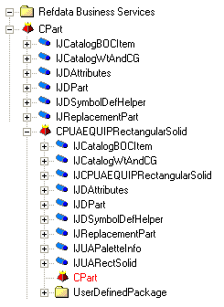
Equipment Reference Entity Data Model
Equipment Shapes
CPUAEQUIPxxxxxx
Class
Interface
Notes:
select * from JDPart x1
join JUAPaletteInfo x2 on x2.oid = x1.oid

Slide 24
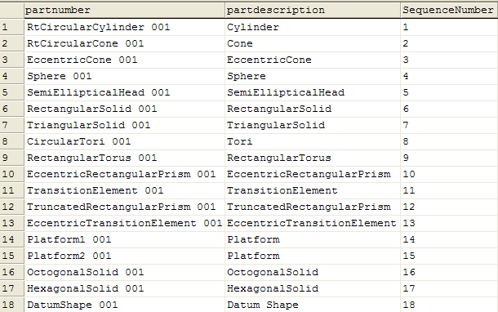
Equipment Reference Entity Data Model
Equipment Shapes
select
partnumber,
partdescription,
SequenceNumber
from JDPart x1
join JUAPaletteInfo x2 on x2.oid = x1.oid
order by SequenceNumber
Notes:
select * from JDPart x1
join JUAPaletteInfo x2 on x2.oid = x1.oid
select
*
from
JDPart x1
join XPartClassContainsParts x2 on x2.oiddestination = x1.oid
join JDPartClass x3 on x3.oid = x2.oidorigin
where x3.PartClassType like '%SketchCrossSectionsClass%'

Slide 25
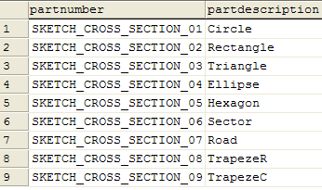
Equipment Reference Entity Data Model
Equipment Shapes
select
partnumber,
partdescription
from
JDPart x1
join XPartClassContainsParts x2 on x2.oiddestination = x1.oid
join JDPartClass x3 on x3.oid = x2.oidorigin
where x3.PartClassType like '%SketchCrossSectionsClass%'
Notes:
select * from JDPart x1
join JUAPaletteInfo x2 on x2.oid = x1.oid
select
*
from
JDPart x1
join XPartClassContainsParts x2 on x2.oiddestination = x1.oid
join JDPartClass x3 on x3.oid = x2.oidorigin
where x3.PartClassType like '%SketchCrossSectionsClass%'

Slide 26
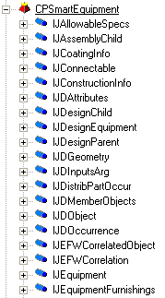
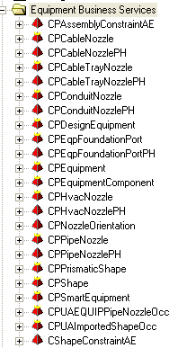
Equipment Entity Data Model
Interface
Class

Slide 27
Equipment Entity Data Model
Generic Object interfaces
The IJDObject interface is a required interface for almost all objects. This interface provides access to the permission group for the object, the status, name of the user who created and last modified the object and the date and time for creation and last modification.
The IJDAttributes interface is required for the equipment object to support user-defined attributes.
The IJNamedItem interface provides the name property, a type string and an icon for all named objects.

Slide 28
Equipment Entity Data Model
Display/Locate interfaces
IJGeometry: This interface is a required if the BO has geometry.
IJGraphicEntity: This interface is a required if the BO is displayable.
IJModelLocate: This interface is used to allow client components to graphically locate all of the graphical components of a standard equipment object.
IJOccurrence: This interface provides a property that allows the matrix to be retrieved or set. A matrix defines the origin and orientation of an equipment object.

Slide 29
Equipment Entity Data Model
Equipment specific interfaces
IJEquipment: This interface is used to provide a common interface for both catalog equipment and design equipment. This interface also provides methods to get and set the position and orientation of the equipment.
IJEquipmentFurnishings: This interface is used to type all business objects that are required to show up under the Equipment&Furnishings node.

Slide 30
Equipment Entity Data Model
IJWeightCG: This interface provides both the wet and dry weights and center of gravity for an object.
IJFoulCheck: The CPSmartEquipment class implements the IJFoulCheck interface which is used to identify which objects should be checked for interferences with other object.
IJSystemChild: In order for an object to participate in the System Hierarchy, it must implement either IJSystemChild and establish a relationship to a design parent.
IJMfgParent and IJAssemblyChild: Equipment Assembly objects can also participate in the Assembly hierarchy. As a part, it can be associated to an Assembly parent object using the Assembly relationship that is established between IJMfgParent and IJAssemblyChild. This relationship allows the equipment part to be associated to one assembly parent object.

Slide 31
Equipment Entity Data Model
IJCoatingInfo: This interface provides code-listed properties to describe the coating properties for SP3D parts. These include coating type description and coating color.
IJConstructionInfo: This interface provides information on the construction status of a part. The status indicates whether the part is new, existing, future, etc.
IJFabricationInfo: This interface provides information on who is responsible for the fabrication of the part.

Slide 32
Equipment Entity Data Model
IJDistribPartOccur: This interface is used to establish a relationship to the distribution ports.
IJOccInsulation: This interface is used to define the purpose, material and thickness for insulation for the standard equipment.
IJConnectable: This interface is used to return a set of equipment foundation ports.

Slide 33
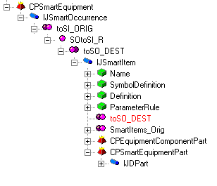
Equipment Entity Data Model
Smart Occurrence to Smart Item Relationship
The smart occurrence is related to the Smart Item with a relationship named SOtoSI_R.
Relation Collection
Relation
Relation Collection

Slide 34
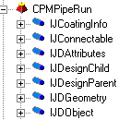
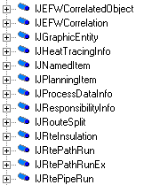
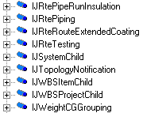
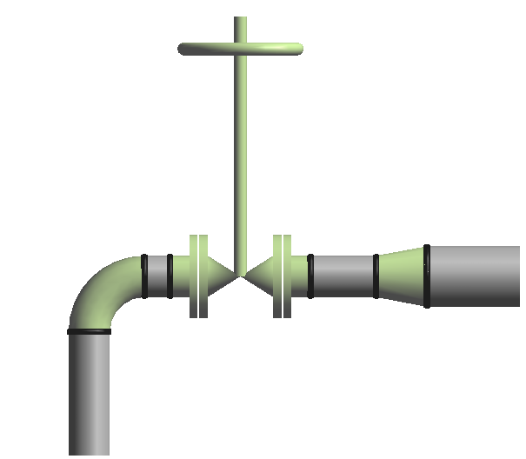
Piping Entities Data Model
PipeRun Interfaces
A PipeRun identifies one or more path features that share a common pipe specification, flow direction, size, temperature, pressure, etc….
One or more runs make up a pipeline.
Pipe Run 1
Pipe Run 2
4 NPD
6 NPD

Slide 35
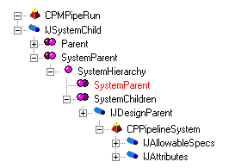
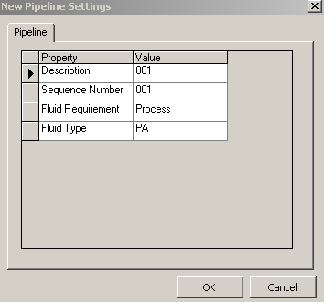
Piping Entities Data Model
PipeRun and Pipeline Relationship
System Hierarchy Relation
The system hierarchy relationship is used to specify that a run (IJSystemChild) has a parent system (JDesignParent)
Relation Collection
Relation
Relation Collection
Pipeline is a high-level grouping of Pipe Runs that are created in System and Spec Task environment.

Slide 36
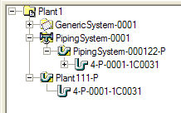

Piping Entities Data Model
Example: returns pipe runs and pipeline names
select
x4.ItemName as PipeRunName,
x3.ItemName as Parent_System
from JRtePipeRun x1
join JNamedItem x4 on x4.oid = x1.oid
join XSystemHierarchy x2 on x2.oiddestination = x1.oid
join JNamedItem x3 on x3.oid = x2.oidorigin
Notes:
select
x4.ItemName as PipeRunName,
x3.ItemName as Parent_System
from JRtePipeRun x1
join JNamedItem x4 on x4.oid = x1.oid
join XSystemHierarchy x2 on x2.oiddestination = x1.oid
join JNamedItem x3 on x3.oid = x2.oidorigin

Slide 37
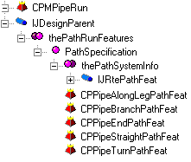
Piping Entities Data Model
PipeRun and Features Relationship
Path Specification Relation
All path features are related to a run. This relationship allows the path feature to retrieve the specification and rules that it needs to meet from the run.
Relation Collection
Relation
Relation Collection
Along Leg Feature: RUNCHANGE
Features define the geometry path of the run and your design intent that occurs along the path. When you route a pipe run, you place features.
Turn Feature
Straight Feature
Along Leg Feature: COMPONENT
End Feature
End Feature

Slide 38
Piping Entities Data Model
Example: Select empty runs:
select distinct x1.oid from JRtePipeRun x1
WHERE NOT EXISTS
(select 1 from XPathSpecification x2 where x1.oid = x2.oidorigin)

Slide 39
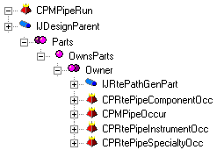
Piping Entities Data Model
PipeRun and Parts Relationship
Owns Parts Relation
The OwnsParts relationship is used to specify that a part occurrence is a child of a run.
Relation Collection
Relation
Relation Collection

Slide 40
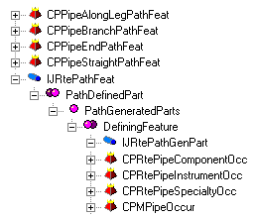
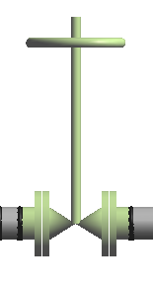
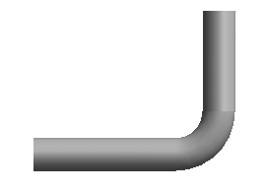
Piping Entities Data Model
Feature and Part Relationship
PathGeneratedParts Relation
This relationship identifies the part occurrences that are generated from a given feature based on specifications. For a feature representing a component, there may be one or more generated parts. For a pipe, there may be multiple features associated with a single generated part.
Relation Collection
Relation
Relation Collection
Straight Feature
Along Leg Feature
Parts:
- Mating Flanges
- Gate Valve
- Gaskets/Bolts/Nuts
Part: Pipe
Turn Feature
Straight Feature

Slide 41
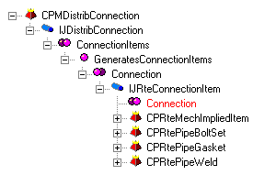

Piping Entities Data Model
Distribution Connection Relationship
GeneratesConnectionItems Relation
This relationship identifies
the connection items that are generated from a given
distribution connection.
Relation Collection
Relation
Relation Collection
Weld
Distribution
connection
Port 1
Port 1
Weld
Distribution
connection
Port 2
Port 1

Slide 42
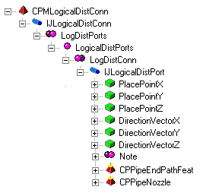
Piping Entities Data Model
Logical Distribution Connection Relationship
LogicalDistPorts Relation
This relationship identifies
the connection between an equipment nozzle and the end feature of a path leg.
Relation Collection
Relation
Relation Collection

Slide 43
Feature Based Model
Leg 1
End Feature
Straight Feature
Turn Feature
Generated parts
Pipe
Port1
Elbow
Port1
Port2
Distribution
connection
Port2
Weld
Distribution
connection
Leg 2
Weld
Port1
Straight Feature
Pipe
Port2
End Feature

Slide 44
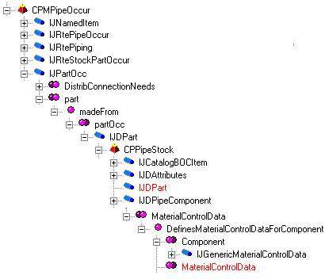
Piping Data Model
Example: Query all pipe occurrences

Slide 45

Piping Data Model
Example: Query all pipe occurrences
Select
x3.IndustryCommodityCode,
x3.PrimarySize,
x3.PriSizeNPDUnits,
Sum (x1.length) as 'TotalLength (m)'
from JRteStockPartOccur x1
Join XmadeFrom x2 on x2.oidorigin = x1.oid
Join JDPipeComponent x3 on x3.oid = x2.oiddestination
Group by x3.IndustryCommodityCode, x3.PrimarySize, x3.PriSizeNPDUnits

Slide 46
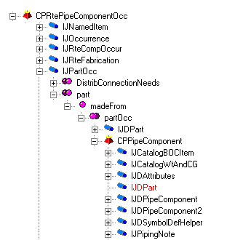
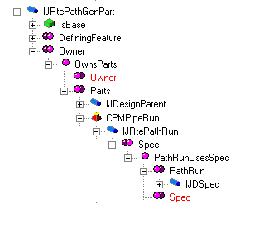
Piping Data Model
Example: Query all pipe component occurrences

Slide 47

Piping Data Model
Example: Query all piping component occurrences
select
x3.IndustryCommodityCode,
x9.SpecName,
count(*) as qty
from JRteCompOccur x1
JOIN XMadeFrom x2 ON (x2.OidOrigin = x1.Oid)
JOIN JDPipeComponent x3 ON (x3.Oid = x2.OidDestination)
JOIN XOwnsParts x5 ON (x5.oiddestination = x1.oid)
JOIN JRtePipeRun x6 on (x6.oid = x5.oidorigin)
JOIN XPathRunUsesSpec x7 ON (x7.OidOrigin = x6.oid)
JOIN JDSpec x8 ON (x8.oid = x7.oiddestination)
JOIN JDPipeSpec x9 on (x9.oid = x8.oid)
group by x3.IndustryCommodityCode, x9.SpecName
Notes:
select
x3.IndustryCommodityCode,
x9.SpecName,
count(*) as qty
from JRteCompOccur x1
JOIN XMadeFrom x2 ON (x2.OidOrigin = x1.Oid)
JOIN JDPipeComponent x3 ON (x3.Oid = x2.OidDestination)
JOIN XOwnsParts x5 ON (x5.oiddestination = x1.oid)
JOIN YPartsToRunSpecification x10 on x10.oiddestination = x1.oid
JOIN JDSpec x8 ON (x8.oid = x10.oidorigin)
JOIN JDPipeSpec x9 on (x9.oid = x8.oid)
group by x3.IndustryCommodityCode, x9.SpecName
select
x3.IndustryCommodityCode,
x9.SpecName,
count(*) as qty
from JRteCompOccur x1
JOIN XMadeFrom x2 ON (x2.OidOrigin = x1.Oid)
JOIN JDPipeComponent x3 ON (x3.Oid = x2.OidDestination)
JOIN XOwnsParts x5 ON (x5.oiddestination = x1.oid)
JOIN JRtePipeRun x6 on (x6.oid = x5.oidorigin)
JOIN XPathRunUsesSpec x7 ON (x7.OidOrigin = x6.oid)
JOIN JDSpec x8 ON (x8.oid = x7.oiddestination)
JOIN JDPipeSpec x9 on (x9.oid = x8.oid)
group by x3.IndustryCommodityCode, x9.SpecName

Slide 48
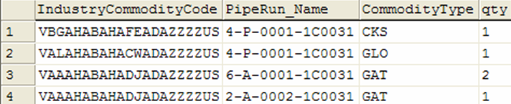
Piping Data Model
Example: Query all valves occurrences
Select
x3.IndustryCommodityCode,
x4.ShortStringValue as 'CommodityType',
count(*) as qty
from JRteCompOccur x1
Join XMadeFrom x2 ON (x2.OidOrigin = x1.Oid)
Join JDPipeComponent x3 ON (x3.Oid = x2.OidDestination)
Join CL_PipingCommodityType x4 ON (x4.ValueID = x3.CommodityType)
WHERE (x3.CommodityClass = 5)
Group by x3.IndustryCommodityCode, x4.ShortStringValue
Notes:
select
x3.IndustryCommodityCode,
x9.SpecName,
x10.ShortStringValue,
count(*) as qty
from JRteCompOccur x1
JOIN XMadeFrom x2 ON (x2.OidOrigin = x1.Oid)
JOIN JDPipeComponent x3 ON (x3.Oid = x2.OidDestination)
JOIN JDPipeComponent2 x4 ON (x4.Oid = x2.OidDestination)
JOIN CL_PipingCommodityType x10 on x10.ValueID = x3.CommodityType
JOIN XOwnsParts x5 ON (x5.oiddestination = x1.oid)
JOIN JRtePipeRun x6 on (x6.oid = x5.oidorigin)
JOIN XPathRunUsesSpec x7 ON (x7.OidOrigin = x6.oid)
JOIN JDSpec x8 ON (x8.oid = x7.oiddestination)
JOIN JDPipeSpec x9 on (x9.oid = x8.oid)
WHERE ( x3.CommodityClass = 5)
group by x3.IndustryCommodityCode, x9.SpecName, x10.ShortStringValue

Slide 49
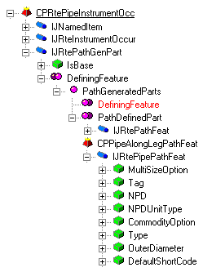
Piping Data Model
Example: Query all Instrument occurrences

Slide 50
Piping Data Model
Example: Query all Instrument occurrences
select
x1.oid,
'Tag/Name'=
Case
when x4.tag = 'undefined'
then x4.tag
else x2.Itemname
End,
x4.NPD,
x4.NPDUnitType
from JRteInstrument x1
join JNamedItem x2 ON x2.oid = x1.oid
join XPathGeneratedParts x3 on x3.oiddestination = x1.oid
join JRtePipePathFeat x4 on x4.oid = x3.oidorigin
Notes:
select
x1.oid,
'Tag/Name'=
Case
when x4.tag = 'undefined'
then x4.tag
else x2.Itemname
End,
x4.NPD,
x4.NPDUnitType
from JRteInstrument x1
join JNamedItem x2 ON x2.oid = x1.oid
join XPathGeneratedParts x3 on x3.oiddestination = x1.oid
join JRtePipePathFeat x4 on x4.oid = x3.oidorigin
select x1.role, x1.accessright, x3.name, x3.permissiongroupid, x5.name, x5.SiteServer, x5.NamingString
from jaccesscontrolrule x1 join XPermissionGroupContainsRules x2 on x1.oid = x2.oiddestination
join JDPermissionGroup x3 on x3.oid = x2.oidorigin
join XPermissionGroupHasLocation x4 on x3.oid = x4.oidorigin
join JLocation x5 on x5.oid = x4.oiddestination Select objects based on user login: ----------------------------------------
select * from jdobject ob JOIN juserlogin u ON (u.Oid = ob.UIDCreator) where userlogin = 'ingrppo\rhim'

Slide 51
Naming Rules
Customized component that allows users to define rules for formatting the names of business objects
Currently, the naming rule is a Visual Basic component
Name can be comprised of the following:
  Object type
  Object properties
  Primary organizational relationships
    System
    Space
    Assembly
    Work Breakdown
  Other relationships
    Connection

Slide 52
Naming Rules - Reference Data
Naming rules are associated to an object class
Multiple rules can be defined for each class of object
  If multiple rules are provided in the catalog, the user must select the rule to apply when objects are created
A rule can also be shared by multiple object classes
DefaultNameRule1
Object
DefaultNameRule2
Object
DefaultNameRule3
Object
DefaultNameRule4
Object
DefaultNameRule5

Slide 53
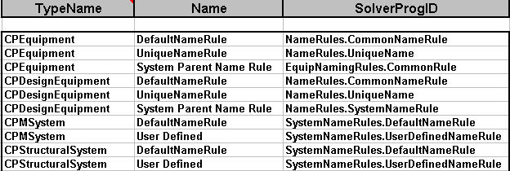
Naming Rules - Reference Data
Mapping of rules to object classes
Example: GenericNamingRules.xls
…\CatalogData\BulkLoad\Datafiles
Object Type Name in GUI VB Component ProgID

Slide 54
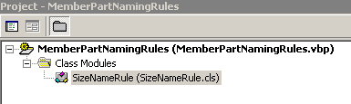
Naming Rules - Creation
Visual Basic component
Implements IJNameRule
ComputeName
  This method is used to format the name of an object
GetNamingParents
  This method is used to return the related parent object or objects that are used in forming a name
IJNameRule
NameRule
ComputeName()
GetNamingParents()
COM
Interface

Slide 55
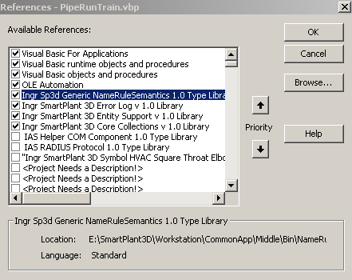
Naming Rules - Reference Libraries
  Ingr Sp3D Generic NameRuleSemantics 1.0 Type Library
  Ingr SmartPlant 3D Error Log v1.0 Library
  Ingr SmartPlant 3D Entity Support v 1.0 Library
  Ingr SmartPlant 3D Core Collections v 1.0 library

Slide 56
IJNameRule_ComputeName
This method is used to format the name of an object
  Private sub IJNameRule_ComputeName
  (
  ByVal oObject as object ‘ Object being named
  ByVal oParents as IJElements ‘ Naming Parents collection
  ByVal oActiveEntity as object ‘Naming rules active entity
  )

Slide 57

IJNameRule_ComputeName
Example (Constant Name)
Private Sub IJNameRule_ComputeName(ByVal oObject As Object, _
ByVal elements As IJElements, ByVal oActiveEntity As Object)
Dim oChildNamedItem As IJNamedItem
Dim strChildName As String
Set oChildNamedItem = oObject
strChildName = “MyName”
oChildNamedItem.Name = strChildName
Set oChildNamedItem = Nothing
Notes:
Dim oChildNamedItem As IJNamedItem
Dim strChildName As String
Set oChildNamedItem = oObject
strChildName = "MyName"
oChildNamedItem.Name = strChildName
Set oChildNamedItem = Nothing

Slide 58
Naming Rules - Error Handling
When errors occur in retrieving properties or related objects, proper error handling is important
  Use the middle tier error log to write specific information
    Dim oErrors as IJEditErrors ' middle tier errors
    Private Const E_FAIL = -2147467259
    …..
    Private Sub Class_Initialize()
    Set oErrors = new IMSErrorLog.JServerErrors
    End Sub
    ….
    label:
    oErrors.Add err.Number, Method, err.Description
    Err.Raise E_FAIL

Slide 59
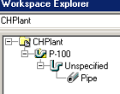
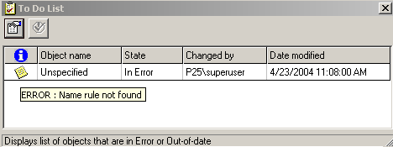
Naming Rules - Error Handling
If a name rule returns an error, the generic semantic will trap the error
  Set the name to “unspecified”
  Add the object to the To Do list

Slide 60
Naming Rules - Services
Attribute Helper service
Relation Helper service
Naming counter service
GetNamingParents Method

Slide 61


Attribute Helper Service
Ingr SmartPlant 3D Attributes v 1.0 Library
Get Object attributes
Need to know the interface and property names.
Dim oAttributes As IJDAttributes
Set oAttributes = oObject
Dim strSeqNum As String
strSeqNum = oAttributes.CollectionOfAttributes("IJPipelineSystem").Item("SequenceNumber").Value
Notes:
Dim oAttributes As IJDAttributes
Set oAttributes = oObject
Dim strSeqNum As String
strSeqNum = oAttributes.CollectionOfAttributes("IJPipelineSystem").Item("SequenceNumber").Value

Slide 62

Attribute Helper Service
Dim FluidCodeID As Long
Dim strFluidCode As String
strFluidCode = vbNullString
Dim m_oCodeListMetadata As IJDCodeListMetaData
Set m_oCodeListMetadata = GetCatalogResourceManager
FluidCodeID = oAttributes.CollectionOfAttributes("IJPipelineSystem").Item("FluidCode").Value
strFluidCode = m_oCodeListMetadata.ShortStringValue("FluidCode", FluidCodeID)
strChildName = strFluidCode & "-" & strSeqNumber
oChildNamedItem.Name = strChildName
Set oChildNamedItem = Nothing
Set oAttributes = Nothing

Slide 63
Attribute Helper Service (Cont’s)
Example 1: Pipeline (Final code)
Dim oChildNamedItem As IJNamedItem
Dim strChildName As String
Set oChildNamedItem = oObject
strChildName = vbNullString
Dim oAttributes As IJDAttributes
Set oAttributes = oObject
Dim strSequenceNumber As String
strSequenceNumber = oAttributes.CollectionOfAttributes("IJPipelineSystem").Item("SequenceNumber").Value
Dim FluidCodeID As Long
Dim strFluidCode As String
strFluidCode = vbNullString
………

Slide 64
Attribute Helper Service (Cont’s)
…..
Set m_oCodeListMetadata = GetCatalogResourceManager
FluidCodeID = oAttributes.CollectionOfAttributes("IJPipelineSystem").Item("FluidCode").Value
strFluidCode = m_oCodeListMetadata.ShortStringValue("FluidCode", FluidCodeID)
strChildName = strFluidCode & "-" & strSequenceNumber
oChildNamedItem.Name = strChildName
Set oChildNamedItem = Nothing
Set oAttributes = Nothing
Notes:
Dim m_oCodeListMetadata As IJDCodeListMetaData
Private Sub IJNameRule_ComputeName(ByVal oObject As Object, ByVal elements As IJElements, ByVal oActiveEntity As Object)
Const METHOD = "IJNameRule_ComputeName"
On Error GoTo label
If oObject Is Nothing Then
Err.Raise vbInvalidArg, Module, METHOD
Exit Sub
End If
' Insert your Code
Dim oChildNamedItem As IJNamedItem
Dim strChildName As String
Set oChildNamedItem = oObject
strChildName = vbNullString
Dim oAttributes As IJDAttributes
Set oAttributes = oObject
Dim strSequenceNumber As String
strSequenceNumber = oAttributes.CollectionOfAttributes("IJPipelineSystem").Item("SequenceNumber").Value
Dim FluidCodeID As Long
Dim strFluidCode As String
strFluidCode = vbNullString
Set m_oCodeListMetadata = GetCatalogResourceManager
FluidCodeID = oAttributes.CollectionOfAttributes("IJPipelineSystem").Item("FluidCode").Value
strFluidCode = m_oCodeListMetadata.ShortStringValue("FluidCode", FluidCodeID)
strChildName = strFluidCode & "-" & strSequenceNumber
oChildNamedItem.Name = strChildName
Set oChildNamedItem = Nothing
Set oAttributes = Nothing
Exit Sub
label:
' log the error in middle tier and propagate the error code to the caller
m_oErrors.Add Err.Number, "IJNameRule_ComputeName", Err.Description
Err.Raise E_FAIL
End Sub

Slide 65

Attribute Helper Service
Example 2: PipeRun
Dim A as IJDAttributes
Set A = oObject
‘get the NPD of the current Run from the IJRtePipeRun interface
strNPD = A.CollectionOfAttributes(“IJRtePipeRun").Item(“NPD").Value
Dim A as IJDAttributes
Set A = oObject
‘get the NPD of the current Run from the IJRtePipeRun interface
strNPD = A.CollectionOfAttributes(“IJRtePipeRun").Item(“NPD").Value

Slide 66

Attribute Helper Service (Cont’s)
Dim oChildNamedItem As IJNamedItem
Dim strChildName As String
Set oChildNamedItem = oObject
strChildName = vbNullString
Dim oAttributes As IJDAttributes
Set oAttributes = oObject
' Get NPD and Unit
Dim strNPD As String
Dim strNPDUnitType As String
strNPD = CStr(oAttributes.CollectionOfAttributes("IJRtePipeRun").Item("NPD").Value)
strNPDUnitType = oAttributes.CollectionOfAttributes("IJRtePipeRun").Item("NPDUnitType").Value

Slide 67
Attribute Helper Service (Cont’s)
If strNPDUnitType = "in" Then
strNPDUnitType = Chr(34)
End If
strChildName = strNPD & strNPDUnitType
oChildNamedItem.Name = strChildName
Set oChildNamedItem = Nothing
Set oAttributes = Nothing
Notes:
Private Sub IJNameRule_ComputeName(ByVal oObject As Object, ByVal elements As IJElements, ByVal oActiveEntity As Object)
Const METHOD = "IJNameRule_ComputeName"
On Error GoTo label
If oObject Is Nothing Then
Err.Raise vbInvalidArg, Module, METHOD
Exit Sub
End If
' Insert your Code
Dim oChildNamedItem As IJNamedItem
Dim strChildName As String
Set oChildNamedItem = oObject
strChildName = vbNullString
Dim oAttributes As IJDAttributes
Set oAttributes = oObject
' Get NPD and Unit
Dim strNPD As String
Dim strNPDUnitType As String
strNPD = CStr(oAttributes.CollectionOfAttributes("IJRtePipeRun").Item("NPD").Value)
strNPDUnitType = oAttributes.CollectionOfAttributes("IJRtePipeRun").Item("NPDUnitType").Value
If strNPDUnitType = "in" Then
strNPDUnitType = Chr(34)
End If
'Get specName
Dim oRelationHelper As IMSRelation.DRelationHelper
Dim oCollection As IMSRelation.DCollectionHelper
Set oRelationHelper = oObject
Dim oPipeSpec As IJDPipeSpec
Dim strSpecName As String
Set oCollection = oRelationHelper.CollectionRelations("IJRtePipeRun", "PipeSpecUsed")
Set oPipeSpec = oCollection.Item(1)
strSpecName = oPipeSpec.SpecName
'Get Parent
Dim oParentNamedItem As IJNamedItem
Dim strParentName As String
strParentName = vbNullString
Set oParentNamedItem = elements.Item(1)
strParentName = oParentNamedItem.Name
Set m_oCodeListMetadata = GetCatalogResourceManager
Dim HeatTracedID As Long
Dim strHeatTraced As String
strHeatTraced = vbNullString
HeatTracedID = oAttributes.CollectionOfAttributes("IJHeatTracingInfo").Item("HeatTracingRequirement").Value
strHeatTraced = m_oCodeListMetadata.ShortStringValue("HeatTracingRequirement", HeatTracedID)
Dim HeatMediumID As Long
Dim strHeatMedium As String
strHeatMedium = vbNullString
HeatMediumID = oAttributes.CollectionOfAttributes("IJHeatTracingInfo").Item("HeatTracingMedium").Value
strHeatMedium = m_oCodeListMetadata.ShortStringValue("HeatTracingMedium", HeatMediumID)
If HeatTracedID = 1 Or HeatTracedID = 0 Then
strChildName = strNPD & strNPDUnitType & "-" & strSpecName & "-" & strParentName
Else: strChildName = strNPD & strNPDUnitType & "-" & strSpecName & "-" & strParentName & "-" & strHeatMedium
End If
oActiveEntity.NamingParentsString = strChildName
oChildNamedItem.Name = strChildName
'Release BO's
Set oChildNamedItem = Nothing
Set oAttributes = Nothing
Set oRelationHelper = Nothing
Set oCollection = Nothing
Set oPipeSpec = Nothing
Set oParentNamedItem = Nothing
Exit Sub
label:
' log the error in middle tier and propagate the error code to the caller
m_oErrors.Add Err.Number, "IJNameRule_ComputeName", Err.Description
Err.Raise E_FAIL
End Sub

Slide 68

Relation Service
Ingr SmartPlant 3D Relation v 1.0 Library
Provides access to related objects
To use this service you must know the relation collection name and the interface name
Interface name: IJRtePathRun
Relation collection name: Spec
Relation Collection
Relation
Relation Collection

Slide 69

Relation Service (Cont’s)
Dim oRelationHelper As IMSRelation.DRelationHelper
Dim oCollection As IMSRelation.DCollectionHelper
Set oRelationHelper = oObject
Dim oPipeSpec As IJDSpec
Dim strSpecName As String
Set oCollection = oRelationHelper.CollectionRelations("IJRtePathRun", "Spec")
Set oPipeSpec = oCollection.Item(1)
strSpecName = oPipeSpec.SpecName
Notes:
Private Sub IJNameRule_ComputeName(ByVal oObject As Object, ByVal elements As IJElements, ByVal oActiveEntity As Object)
Const METHOD = "IJNameRule_ComputeName"
On Error GoTo label
If oObject Is Nothing Then
Err.Raise vbInvalidArg, Module, METHOD
Exit Sub
End If
' Insert your Code
Dim oChildNamedItem As IJNamedItem
Dim strChildName As String
Set oChildNamedItem = oObject
strChildName = vbNullString
Dim oAttributes As IJDAttributes
Set oAttributes = oObject
' Get NPD and Unit
Dim strNPD As String
Dim strNPDUnitType As String
strNPD = CStr(oAttributes.CollectionOfAttributes("IJRtePipeRun").Item("NPD").Value)
strNPDUnitType = oAttributes.CollectionOfAttributes("IJRtePipeRun").Item("NPDUnitType").Value
If strNPDUnitType = "in" Then
strNPDUnitType = Chr(34)
End If
'Get specName
Dim oRelationHelper As IMSRelation.DRelationHelper
Dim oCollection As IMSRelation.DCollectionHelper
Set oRelationHelper = oObject
Dim oPipeSpec As IJDPipeSpec
Dim strSpecName As String
Set oCollection = oRelationHelper.CollectionRelations("IJRtePipeRun", "PipeSpecUsed")
Set oPipeSpec = oCollection.Item(1)
strSpecName = oPipeSpec.SpecName
'Get Parent
Dim oParentNamedItem As IJNamedItem
Dim strParentName As String
strParentName = vbNullString
Set oParentNamedItem = elements.Item(1)
strParentName = oParentNamedItem.Name
Set m_oCodeListMetadata = GetCatalogResourceManager
Dim HeatTracedID As Long
Dim strHeatTraced As String
strHeatTraced = vbNullString
HeatTracedID = oAttributes.CollectionOfAttributes("IJHeatTracingInfo").Item("HeatTracingRequirement").Value
strHeatTraced = m_oCodeListMetadata.ShortStringValue("HeatTracingRequirement", HeatTracedID)
Dim HeatMediumID As Long
Dim strHeatMedium As String
strHeatMedium = vbNullString
HeatMediumID = oAttributes.CollectionOfAttributes("IJHeatTracingInfo").Item("HeatTracingMedium").Value
strHeatMedium = m_oCodeListMetadata.ShortStringValue("HeatTracingMedium", HeatMediumID)
If HeatTracedID = 1 Or HeatTracedID = 0 Then
strChildName = strNPD & strNPDUnitType & "-" & strSpecName & "-" & strParentName
Else: strChildName = strNPD & strNPDUnitType & "-" & strSpecName & "-" & strParentName & "-" & strHeatMedium
End If
oActiveEntity.NamingParentsString = strChildName
oChildNamedItem.Name = strChildName
'Release BO's
Set oChildNamedItem = Nothing
Set oAttributes = Nothing
Set oRelationHelper = Nothing
Set oCollection = Nothing
Set oPipeSpec = Nothing
Set oParentNamedItem = Nothing
Exit Sub
label:
' log the error in middle tier and propagate the error code to the caller
m_oErrors.Add Err.Number, "IJNameRule_ComputeName", Err.Description
Err.Raise E_FAIL
End Sub

Slide 70
Relation Service (Cont’s)
oChildNamedItem.Name = strChildName & "-“ & strSpecName
Set oChildNamedItem = Nothing
Set oRelationHelper = Nothing
Set oCollection = Nothing
Set oPipeSpec = Nothing
Notes:
Private Sub IJNameRule_ComputeName(ByVal oObject As Object, ByVal elements As IJElements, ByVal oActiveEntity As Object)
Const METHOD = "IJNameRule_ComputeName"
On Error GoTo label
If oObject Is Nothing Then
Err.Raise vbInvalidArg, Module, METHOD
Exit Sub
End If
' Insert your Code
Dim oChildNamedItem As IJNamedItem
Dim strChildName As String
Set oChildNamedItem = oObject
strChildName = vbNullString
Dim oAttributes As IJDAttributes
Set oAttributes = oObject
' Get NPD and Unit
Dim strNPD As String
Dim strNPDUnitType As String
strNPD = CStr(oAttributes.CollectionOfAttributes("IJRtePipeRun").Item("NPD").Value)
strNPDUnitType = oAttributes.CollectionOfAttributes("IJRtePipeRun").Item("NPDUnitType").Value
If strNPDUnitType = "in" Then
strNPDUnitType = Chr(34)
End If
'Get specName
Dim oRelationHelper As IMSRelation.DRelationHelper
Dim oCollection As IMSRelation.DCollectionHelper
Set oRelationHelper = oObject
Dim oPipeSpec As IJDPipeSpec
Dim strSpecName As String
Set oCollection = oRelationHelper.CollectionRelations("IJRtePipeRun", "PipeSpecUsed")
Set oPipeSpec = oCollection.Item(1)
strSpecName = oPipeSpec.SpecName
'Get Parent
Dim oParentNamedItem As IJNamedItem
Dim strParentName As String
strParentName = vbNullString
Set oParentNamedItem = elements.Item(1)
strParentName = oParentNamedItem.Name
Set m_oCodeListMetadata = GetCatalogResourceManager
Dim HeatTracedID As Long
Dim strHeatTraced As String
strHeatTraced = vbNullString
HeatTracedID = oAttributes.CollectionOfAttributes("IJHeatTracingInfo").Item("HeatTracingRequirement").Value
strHeatTraced = m_oCodeListMetadata.ShortStringValue("HeatTracingRequirement", HeatTracedID)
Dim HeatMediumID As Long
Dim strHeatMedium As String
strHeatMedium = vbNullString
HeatMediumID = oAttributes.CollectionOfAttributes("IJHeatTracingInfo").Item("HeatTracingMedium").Value
strHeatMedium = m_oCodeListMetadata.ShortStringValue("HeatTracingMedium", HeatMediumID)
If HeatTracedID = 1 Or HeatTracedID = 0 Then
strChildName = strNPD & strNPDUnitType & "-" & strSpecName & "-" & strParentName
Else: strChildName = strNPD & strNPDUnitType & "-" & strSpecName & "-" & strParentName & "-" & strHeatMedium
End If
oActiveEntity.NamingParentsString = strChildName
oChildNamedItem.Name = strChildName
'Release BO's
Set oChildNamedItem = Nothing
Set oAttributes = Nothing
Set oRelationHelper = Nothing
Set oCollection = Nothing
Set oPipeSpec = Nothing
Set oParentNamedItem = Nothing
Exit Sub
label:
' log the error in middle tier and propagate the error code to the caller
m_oErrors.Add Err.Number, "IJNameRule_ComputeName", Err.Description
Err.Raise E_FAIL
End Sub

Slide 71
IJNameRule_GetNamingParents
This method is used to return the related parent object or objects that are used in forming a name
Private function IJNameRule_GetNamingParents
  (
  ByVal oEntity as object ‘ Object being named
  )
  As IJElements
All the Naming Parents that need to participate in an objects naming are added here to the IJElements collection.
Notes:
Private Function IJNameRule_GetNamingParents(ByVal oEntity As Object) As IJElements
Const METHOD = "IJNameRule_GetNamingParents"
On Error GoTo label
' Set IJNameRule_GetNamingParents = Nothing
' If you need the Parent objects, then Add code Here to get the Naming Parents that will participate in the naming.
Set IJNameRule_GetNamingParents = New IMSCoreCollections.JObjectCollection
Dim oSysChild As IJSystemChild
Set oSysChild = oEntity
Dim oSysParent As IJSystem
Set oSysParent = oSysChild.GetParent
If Not (oSysParent Is Nothing) Then
Call IJNameRule_GetNamingParents.Add(oSysParent)
End If
Set oSysChild = Nothing
Set oSysParent = Nothing
Exit Function
label:
' log the error in middle tier and propagate the error code to the caller
m_oErrors.Add Err.Number, "IJNameRule_GetNamingParents", Err.Description
Err.Raise E_FAIL
End Function

Slide 72
IJNameRule_GetNamingParents
Example (Return No Parent)
Private Function IJNameRule_GetNamingParents(ByVal oEntity As Object) As IJElements
Const METHOD = "IJNameRule_GetNamingParents"
On Error GoTo label
Set IJNameRule_GetNamingParents = Nothing
' If you need the Parent objects, then Add code Here to get the Naming Parents that will participate in the naming.
Exit Function
label:
' log the error in middle tier and propagate the error code to the caller
m_oErrors.Add Err.Number, "IJNameRule_GetNamingParents", Err.Description
Err.Raise E_FAIL
End Function
Notes:
Private Function IJNameRule_GetNamingParents(ByVal oEntity As Object) As IJElements
Const METHOD = "IJNameRule_GetNamingParents"
On Error GoTo label
' Set IJNameRule_GetNamingParents = Nothing
' If you need the Parent objects, then Add code Here to get the Naming Parents that will participate in the naming.
Set IJNameRule_GetNamingParents = New IMSCoreCollections.JObjectCollection
Dim oSysChild As IJSystemChild
Set oSysChild = oEntity
Dim oSysParent As IJSystem
Set oSysParent = oSysChild.GetParent
If Not (oSysParent Is Nothing) Then
Call IJNameRule_GetNamingParents.Add(oSysParent)
End If
Set oSysChild = Nothing
Set oSysParent = Nothing
Exit Function
label:
' log the error in middle tier and propagate the error code to the caller
m_oErrors.Add Err.Number, "IJNameRule_GetNamingParents", Err.Description
Err.Raise E_FAIL
End Function

Slide 73
IJNameRule_GetNamingParents
Example (Return Parent Name)
Private Function IJNameRule_GetNamingParents(ByVal oEntity As Object) As IJElements
Const METHOD = "IJNameRule_GetNamingParents"
On Error GoTo label
Set IJNameRule_GetNamingParents = New IMSCoreCollections.JObjectCollection
Dim oSysChild As IJSystemChild
Set oSysChild = oEntity
Dim oSysParent As IJSystem
Set oSysParent = oSysChild.GetParent
If Not (oSysParent Is Nothing) Then
Call IJNameRule_GetNamingParents.Add(oSysParent)
End If
Set oSysChild = Nothing
Set oSysParent = Nothing
…….
Notes:
Private Function IJNameRule_GetNamingParents(ByVal oEntity As Object) As IJElements
Const METHOD = "IJNameRule_GetNamingParents"
On Error GoTo label
' Set IJNameRule_GetNamingParents = Nothing
' If you need the Parent objects, then Add code Here to get the Naming Parents that will participate in the naming.
Set IJNameRule_GetNamingParents = New IMSCoreCollections.JObjectCollection
Dim oSysChild As IJSystemChild
Set oSysChild = oEntity
Dim oSysParent As IJSystem
Set oSysParent = oSysChild.GetParent
If Not (oSysParent Is Nothing) Then
Call IJNameRule_GetNamingParents.Add(oSysParent)
End If
Set oSysChild = Nothing
Set oSysParent = Nothing
Exit Function
label:
' log the error in middle tier and propagate the error code to the caller
m_oErrors.Add Err.Number, "IJNameRule_GetNamingParents", Err.Description
Err.Raise E_FAIL
End Function

Slide 74

GetNamingParent
'Get Parent
…….
Dim oParentNamedItem As IJNamedItem
Dim strParentName As String
strParentName = vbNullString
Set oParentNamedItem = elements.Item(1)
strParentName = oParentNamedItem.Name
oChildNamedItem.Name = strChildName & “-” & strParentName

Slide 75

Attribute Service
Ingr SmartPlant 3D Attributes v 1.0 Library
m_oCodeListMetadata.ShortStringValue(“Tablename", ValueID)
Get short description of a code list attribute
Set m_oCodeListMeta = GetCatalogResourceManager
Dim HeatTracedID As Long
Dim strHeatTraced As String
strHeatTraced = vbNullString
HeatTracedID =
oAttributes.CollectionOfAttributes("IJHeatTracingInfo").Item("HeatTracingRequirement").Value
strHeatTraced = m_oCodeListMeta.ShortStringValue("HeatTracingRequirement", HeatTracedID)
Dim HeatMediumID As Long
Dim strHeatMedium As String
strHeatMedium = vbNullString
HeatMediumID = oAttributes.CollectionOfAttributes("IJHeatTracingInfo").Item("HeatTracingMedium").Value
strHeatMedium = m_oCodeListMeta.ShortStringValue("HeatTracingMedium", HeatMediumID)

Slide 76
Attribute Service
If HeatTracedID = 1 Then
strChildName = strNPD & strNPDUnitType & "-" & strSpecName & "-" & strParentName
Else: strChildName = strNPD & strNPDUnitType & "-" & strSpecName & "-" & strParentName & "-" & strHeatTraced & "-" & strHeatMedium
End If
oChildNamedItem.Name = strChildName
'Release BO's
Set oChildNamedItem = Nothing
Set oAttributes = Nothing
Set oRelationHelper = Nothing
Set oCollection = Nothing
Set oPipeSpec = Nothing
Set oParentNamedItem = Nothing
Notes:
Private Function GetCatalogResourceManager() As IUnknown
Const METHOD = "GetCatalogResourceManager"
On Error GoTo ErrHandler
Dim oDBTypeConfig As IJDBTypeConfiguration
Dim pConnMiddle As IJDConnectMiddle
Dim pAccessMiddle As IJDAccessMiddle
Dim jContext As IJContext
Set jContext = GetJContext()
Set oDBTypeConfig = jContext.GetService("DBTypeConfiguration")
Set pConnMiddle = jContext.GetService("ConnectMiddle")
Set pAccessMiddle = pConnMiddle
Dim strCatlogDB As String
strCatlogDB = oDBTypeConfig.get_DataBaseFromDBType("Catalog")
Set GetCatalogResourceManager = pAccessMiddle.GetResourceManager(strCatlogDB)
Set jContext = Nothing
Set oDBTypeConfig = Nothing
Set pConnMiddle = Nothing
Set pAccessMiddle = Nothing
Exit Function
ErrHandler:
m_oErrors.Add Err.Number, "GetCatalogResourceManager", Err.Description
Err.Raise E_FAIL
End Function

Slide 77


Attribute Helper Service
Example 3: Member Part
Dim oAttributes As IJDAttributes
Set oAttributes = oObject
Dim MemberTypeID As Long
MemberTypeID = oAttributes.CollectionOfAttributes("ISPSMemberType").Item("TypeCategory").Value
Member Category Desc + Section Name + Location + IndexCounter

Slide 78

Attribute Helper Service
Dim strTableName As String
Dim strMemType As String
strTableName = "StructuralMemberTypeCategory“
Dim m_oCodeListMetadata As IJDCodeListMetaData
If m_oCodeListMetadata Is Nothing Then
Set m_oCodeListMetadata = GetCatalogResourceManager
End If
strMemType = UCase(Left(m_oCodeListMetadata.ShortStringValue(strTableName, MemberTypeID), 2))
Notes:
Dim m_oCodeListMetadata As IJDCodeListMetaData

Slide 79

Relation Helper Service
Dim oRelationHelper As IMSRelation.DRelationHelper
Dim oCollectionHelper As IMSRelation.DCollectionHelper
Set oRelationHelper = oObject
Set oCollectionHelper = oRelationHelper.CollectionRelations("ISPSMemberPartPrismatic", "Generation6_DEST")
Set oRelationHelper = oCollectionHelper.Item(1)
Set oCollectionHelper = Nothing
Set oCollectionHelper = oRelationHelper.CollectionRelations("ISPSPartPrismaticDesign", "Definition_ORIG")
Dim oMembCrossSection As IJCrossSection
Set oMembCrossSection = oCollectionHelper.Item(1)

Slide 80

Attribute Helper Service
Dim strSectionName As String
Set oAttributes = oMembCrossSection
strSectionName =
oAttributes.CollectionOfAttributes("IStructCrossSection").Item("SectionName").Value

Slide 81
Naming Counter Service
  Sp3d NameGenerator 1.0 Type Library
  Naming counter service - generates a unique counter given a basis string
  GetCount(): This method returns a new index number if the basis string is different from the NamingParentString
  GetCountEx(): This method returns the count and the location prefix.
    Dim oNameCounter as IJNameCounter
    Set oNameCounter = New NameGeneratorService
    nCount = oNameCounter.GetCount(oModelResourceMgr, strBasis)
    Sname = strBasis + Str$(nCount)
    Or….
    nCount = oNameCounter.GetCountEx(oModelResourceMgr, strBasis, strLocation)
    Sname = strBasis + Str$(nCount)

Slide 82


Naming Service Architecture
SP3D (Taskhost.exe)
SP3DNameGenerator
COM+ Application On the Administrator machine
NameRule component (PipeRunLineID)
GetCount( pResourceManager, strBasename, * nCount )
NameGeneratorService
UpdateNumber

Slide 83
Naming Counter Service
Dim oNameCounter As IJNameCounter
Set oNameCounter = New GSCADNameGenerator.NameGeneratorService
Dim strLocation As String
strLocation = vbNullString
Dim nCount As Long
Set oModelResourceMgr = GetModelResourceManager
nCount = oNameCounter.GetCountEx(oModelResourceMgr, strChildName, strLocation)
If Not (strLocation = vbNullString) Then
strChildName = strChildName + "-" + strSectionName + "-" + strLocation + "-" +
CStr(nCount)
Else
strChildName = strChildName + "-" + strSectionName + "-" + CStr(nCount)
End If
oChildNamedItem.Name = strChildName

Slide 84
Naming Counter Service
Format the counter
Private Const strCountFormat = "00000“
….
strChildName = strChildName + "-" + strLocation + "-" + Format(nCount, strCountFormat)
Notes:
Private Const strCountFormat = "00000"
Dim m_oCodeListMetadata As IJDCodeListMetaData
Dim oModelResourceMgr As IUnknown
Private Sub IJNameRule_ComputeName(ByVal oObject As Object, ByVal elements As IJElements, ByVal oActiveEntity As Object)
Const METHOD = "IJNameRule_ComputeName"
On Error GoTo label
If oObject Is Nothing Then
Err.Raise vbInvalidArg, Module, METHOD
Exit Sub
End If
' Insert your Code
Dim oChildNamedItem As IJNamedItem
Set oChildNamedItem = oObject
Dim oAttributes As IJDAttributes
Set oAttributes = oObject
Dim MemberTypeID As Long
MemberTypeID = oAttributes.CollectionOfAttributes("ISPSMemberType").Item("TypeCategory").Value
Dim strTableName As String
Dim strMemType As String
strTableName = "StructuralMemberTypeCategory"
If m_oCodeListMetadata Is Nothing Then
Set m_oCodeListMetadata = GetCatalogResourceManager
End If
strMemType = UCase(Left(m_oCodeListMetadata.ShortStringValue(strTableName, MemberTypeID), 2))
Dim oRelationHelper As IMSRelation.DRelationHelper
Dim oCollectionHelper As IMSRelation.DCollectionHelper
Set oRelationHelper = oObject
Set oCollectionHelper = oRelationHelper.CollectionRelations("ISPSMemberPartPrismatic", "Generation6_DEST")
Set oRelationHelper = oCollectionHelper.Item(1)
Set oCollectionHelper = Nothing
Set oCollectionHelper = oRelationHelper.CollectionRelations("ISPSPartPrismaticDesign", "Definition_ORIG")
Dim oMembCrossSection As IJCrossSection
Set oMembCrossSection = oCollectionHelper.Item(1)
Dim strSectionName As String
Set oAttributes = oCollectionHelper.Item(1)
strSectionName = oAttributes.CollectionOfAttributes("IStructCrossSection").Item("SectionName").Value
Dim strChildName As String
strChildName = strMemType
Dim oNameCounter As IJNameCounter
Set oNameCounter = New GSCADNameGenerator.NameGeneratorService
Dim strLocation As String
strLocation = vbNullString
Dim nCount As Long
Set oModelResourceMgr = GetModelResourceManager
nCount = oNameCounter.GetCountEx(oModelResourceMgr, strChildName, strLocation)
If Not (strLocation = vbNullString) Then
strChildName = strChildName + "-" + strSectionName + "-" + strLocation + "-" + Format(nCount, strCountFormat)
Else
strChildName = strChildName + "-" + strSectionName + "-" + CStr(nCount)
End If
oChildNamedItem.Name = strChildName
Set oNameCounter = Nothing
Set oChildNamedItem = Nothing
Set oCollectionHelper = Nothing
Set oRelationHelper = Nothing
Set oAttributes = Nothing
Set oMembCrossSection = Nothing
Exit Sub
label:
' log the error in middle tier and propagate the error code to the caller
m_oErrors.Add Err.Number, "IJNameRule_ComputeName", Err.Description
Err.Raise E_FAIL
End Sub

Slide 85
Binary Compatibility
A VB ActiveX DLL/OCX is a COM Class
  That is, it has a CLSID
When you build DLL, VB generates a new CLSID
Project that have your ActiveX DLL as a reference are then “broken”
  Reference is marked “Missing”
Solution: when you get a good build, save the DLL as a Binary-Compatible reference mark
  Make all future builds binary compatible to it
  This preserves the CLSID (& other project’s references!)

Slide 86

Naming Rules - Re-compute
Naming rule semantic is responsible for calling the ComputeName when the following actions occur:
  A property on the named object is modified.
  A property on the naming parent object is modified.
  System parent or assembly parent is changed.
Use the Update Name to re-fire the naming rule semantic to all objects in the select set

Slide 87

Overview
Pre-defined parts are defined in the Catalog.
Ten_Specs_CatalogData.xls
Model DB
Catalog DB
.xls
Bulk-load
Part
Occurrence A1
Madefrom
Class
Part
Occurrence A2
Part1
Part2
Symbol
Code
Symbol
Definition
SP3DWNFlange.CWNFlange

Slide 88

Symbol Overview
Symbols: What is it ?
……...Reusability of Graphical Entities
Probably the most used entity by SmartPlant 3D Applications. Example:
  Piping
  Electrical
  Hvac
  Equipment
  Structure
The end user creates a graphical or programmed construction of the symbol, save it and expose it through the Reference Data

Slide 89



Symbol Overview
Parametric symbols: It means that some parameters (inputs of the symbol) can ‘drive’ the outputs (graphical entities).

Slide 90


Symbol Overview
Functionality
  Support Multiple Representations: allows to have several different aspects of the same components.
  it is up to the symbol definition designer to define the aspects that the symbol will support.
  The aspects to be displayed is controlled by the client tier (Format View dialog).
Simple Physical Aspect Detailed Physical Aspect

Slide 91

Symbol Overview
Functionality
  Support the functionality of penetrating a symbol occurrence at locate time to identify some of its members or constituent.

Slide 92

Symbol Overview
Functionality
  Support Nesting: Nesting means that a symbol can be made of symbols.

Slide 93



Symbol Machinery
Definition
  Symbol: Displayable graphic entities (An instantiation of the symbol definition)
  Symbol Definition: The definition of a symbol
Visual Basic Component
Symbol Definition
Descriptions of:
-Inputs
Representations
Server
User methods
Evaluate Functions
VB Symbol
Symbol
Graphical entities:
3Dprojections
3Dpoints
3Dlines
Solid Edge file
Shape 2D file

Slide 94


Symbol Definition – Visual Basic
Visual Basic Project (.vbp) and Class Modules (.cls) files:
Each Class Module file represents a different Aspect of the symbol.
The Project is a collection of supporting code that identifies the number of aspects and outputs for the symbol.
Quick Symbol Template creation is achieved through SP3D’s Part Definition Wizard.
The basGeom3D contains functions to create many of the common construction shapes. They are utilized when creating the output constructions in the class modules.
The final item of this symbol is a .dll file or cab file. (The source code should be preserved for future changes, but does not need to be distributed with the .dll file in order for the symbol to work.)

Slide 95

Symbol Definition – Solid Edge
Solid Edge Assembly (.asm) and Part (.par) files:
Each SE Part file represents a different aspect of the symbol.
The Assembly is a collection of part files that references position of the parts to one another.
Ports are identified on symbol by executing the Solid Edge Port macro and selecting the construction that represents the placement for the port.
The final item of this symbol is one .asm file per symbol, and one .par file for every aspect that the symbol lives.

Slide 96

Symbol Definition – 2D Symbols
2D Symbols Cross-section file (.sym):
Each Cross-section file contains layers.
The information contained on the default layer represents the cross-section Physical Aspect. There are also other layers that contain dimension data for the symbol.

Slide 97
Symbol Definition – Visual Basic
VB Symbol is a Visual Basic component
Implements IJDUserSymbolServices
  IJDUserSymbolServices_InstanciateDefinition
  IJDUserSymbolServices_InitializeSymbolDefinition
  IJDUserSymbolServices_GetDefinitionName
  IJDUserSymbolServices_InvokeRepresentation
VB Symbol
IJDUserSymbolServices_InstanciateDefinition
IJDUserSymbolServices_InitializeSymbolDefinition
IJDUserSymbolServices_GetDefinitionName
IJDUserSymbolServices_InvokeRepresentation

Slide 98
Symbol
Visual Basic Project (.vbp) and Class Modules (.cls) files:
VB Project
Display graphics for the BO
Class_Initialize()
IJDUserSymbolServices_InstanciateDefinition
IJDUserSymbolServices_InitializeSymbolDefinition
IJDUserSymbolServices_GetDefinitionName
IJDUserSymbolServices_InvokeRepresentation
Class_Terminate()
Symbol Code
CPhysical
Geometry3D.bas
CInsulation
COperation
Geometry3D.bas: contains basic functions to create basic geometries and ports. Example:
Public Function PlaceProjection(ByVal objOutputColl As Object, _
ByVal objCurve As Object, _
ByVal axisVector As AutoMath.DVector, _
height As Double, _
isCapped As Boolean)

Slide 99
Symbol Definition – Visual Basic
User Symbol Services Object (IJDUserSymbolServices):
Set the following information (Class_Initialize routine):
  Inputs: are entries that drive the graphic representation of the symbol
  Outputs: Graphics Output Description
  Representation(s): Description
  IJSymbolHelper
  This interface provides methods to help in creating the definition of a VB symbol. It provides the implementation of the IJDUserSymbolServices interface as well as provide support for declaring the inputs and outputs of the symbol.

Slide 100

Symbol – Visual Basic
Inputs
The graphic representations (aspects) of a symbol can be driven by a set of inputs that are numeric values (parameter).
An input is identified by a name, has some properties and optionally a default value.
m_oSymbolHelper.NumInputs = 1
m_oSymbolHelper.AddInputDef 1, "FacetoFace", "FacetoFace“, 4
Notes:
Name is case sensitive

Slide 101

Symbol – Visual Basic
Outputs
The representation is described as a multi-level hierarchy of outputs characterized by a name, description and Aspects (Representation id).
m_oSymbolHelper.NumOutputs = 3
m_oSymbolHelper.AddOutputDef 1, "Body1", "Body1", 1
m_oSymbolHelper.AddOutputDef 2, “port1", “port1", 1
m_oSymbolHelper.AddOutputDef 3, “port2", “port 2", 1

Slide 102

Symbol – Visual Basic
Representation
An representation is identified by a name, representation id and optionally a description.
Representation id is defined as the aspect value written in powers of two.
m_oSymbolHelper.NumAspects = 1
m_oSymbolHelper.AddAspectDef 1, "SimplePhysical", "SimplePhysical", 1

Slide 103
SP3D Part definition VB Wizard
What is it?
What does it do?
SP3D Part definition VB Wizard
..\SmartPlant3D\Programming\Tools\SymbolWizard
Workstation Machine:
SP3D Programming Resources available under
[Install Directory]\Programming Resources
Source code of all symbols, rules, and example codes

Slide 104


SP3D Part definition VB Wizard
..\SP3D Symbol Wizard\Templates
Run Wizard from Add-ins or Tool bar

Slide 105

SP3D Part Definition VB Wizard
Create Symbols for Piping Components with user defined Inputs
Standard Data Types Attributes:
  - Double
  - String
Automatic positioning and orientation of key ports.

Slide 106
SP3D Part Definition VB Wizard
Shared Modules:
  - Intergraph Geometrical functions
  - Company standard
Generation of Error Handling module
Automatic attachment of key References:
  Ingr Sp3d RefDataGlobal 1.0 Type Library.
  Ingr Cmn App Symbols Custom Cache 1.0 Type Library
  Ingr Sp3d Nozzle Entities 1.0 Type Library
  Ingr Sp3d Nozzle Facelets 1.0 Type Library
  Ingr Sp3d PartFacelets 1.0 Type Library
  Ingr Sp3d Symbol Services 1.0 Type Library
  Ingr SmartPlant 3D Client Collections v 1.0 Library
  Ingr SmartPlant 3D Symbol Entities v 1.0 Library
  Ingr SmartPlant 3D Units of Measure v 1.0 Library
  Ingr SmartPlant Error Log v 1.0 Library
  RefDataCableTrayFacelets 1.0 Type Library

Slide 107
Creating a Symbol: Wizard Page 1
Fields:
  Project Name
  Class Name
  Project Description
  Author
  Company
  Intergraph common module location
  Custom common module location
  Save Project as
  Create bulkload spreadsheet

Slide 108

Creating a Symbol: Wizard Page 2
Fields:
  Catalog server
  Catalog name
  Part class name
  Part class description
  Classification
  Save in Excel file

Slide 109


Creating a Symbol: Wizard Page 3 & 4
Fields:
  Interface Name
  Attribute Name
  Attribute User Name
  Data Type
  Primary Unit
  Description
  Default
  Symbol Parameter

Slide 110

Creating a Symbol: Wizard Page 5
Fields:
  Nozzles
  Nozzle Type
  Outputs
    Name
    Description
    Type
    Aspects…

Slide 111

Creating a Symbol: Wizard Page 6
Fields:
  Save current settings as default

Slide 112

What does the Wizard Produce?
A VB Project that includes:
Supporting Classes and procedures for the Symbol
Classes and procedures based on the User input during the Wizard Execution
Excel templates based on the User input during the Wizard Execution

Slide 113
Inputs & Outputs
Example 1: (Input & Output Definitions)
  ' Inputs
  m_oSymbolHelper.NumInputs = 1
  m_oSymbolHelper.AddInputDef 1, "FacetoFace", "FacetoFace", 2
  ' Outputs
  m_oSymbolHelper.NumOutputs = 3
  m_oSymbolHelper.AddOutputDef 1, "Body1", "Body", 1
  m_oSymbolHelper.AddOutputDef 2, "PipingNoz1", "Nozzle 1", 1
  m_oSymbolHelper.AddOutputDef 3, "PipingNoz2", "Nozzle 2", 1
  ' Aspects
  m_oSymbolHelper.NumAspects = 1
  m_oSymbolHelper.AddAspectDef 1, "SimplePhysical", "SimplePhysical", 1

Slide 114
Physical
Example 1: Code (Body)
  iOutput = 0
  ' Insert your code for output (FABody)
  RetrieveParameters 1, oPartFclt, m_OutputColl, pipeDiam, flangeThick, flangeDiam, cptOffset, depth
  Dim stPosition As IJDPosition
  Dim enPosition As IJDPosition
  Set stPosition = New DPosition
  Set enPosition = New DPosition
  stPosition.Set -parFacetoFace / 2 + flangeThick, 0, 0
  enPosition.Set parFacetoFace / 2, 0, 0
  iOutput = iOutput + 1
  Set ObjBody1 = m_oGeomHelper.CreateCone(arrayOfOutputs(iOutput), stPosition, enPosition, pipeDiam + flangeDiam / 4, pipeDiam )

Slide 115
Physical
Example 1: Code (Pipe Nozzle)
  ' Place Nozzle 1
  RetrieveParameters 1, oPartFclt, m_OutputColl, pipeDiam, flangeThick, flangeDiam, cptOffset, depth
  Dim oPlacePoint As AutoMath.DPosition
  Dim oDir As AutoMath.DVector
  Dim objNozzle As GSCADNozzleEntities.IJDNozzle
  Dim faceToFace As Double
  Set oPlacePoint = New AutoMath.DPosition
  Set oDir = New AutoMath.DVector
  faceToFace = arrayOfInputs(2)
  oPlacePoint.Set -faceToFace / 2 - cptOffset + depth, 0, 0
  oDir.Set -1, 0, 0
  Set objNozzle = CreateNozzle(1, oPartFclt, m_OutputColl, oDir, oPlacePoint)
  ' Set the output
  iOutput = iOutput + 1
  m_OutputColl.AddOutput arrayOfOutputs(iOutput), objNozzle
  Set objNozzle = Nothing
  ' Place Nozzle 2
  RetrieveParameters 2, oPartFclt, m_OutputColl, pipeDiam, flangeThick, flangeDiam, cptOffset, depth
  oPlacePoint.Set faceToFace / 2 + cptOffset - depth, 0, 0
  oDir.Set 1, 0, 0
  Set objNozzle = CreateNozzle(2, oPartFclt, m_OutputColl, oDir, oPlacePoint)
  ' Set the output
  iOutput = iOutput + 1
  m_OutputColl.AddOutput arrayOfOutputs(iOutput), objNozzle

Slide 116


Methods
Geometry3D.bas IJSymbolGeometryHelper

Slide 117

Custom Interfaces Sheet
The Custom Interfaces sheet defines the customized user interfaces and attributes (properties) for the part classes in the workbook.
An interface is a collection of attributes.
Provides a mechanism to map the attributes of the part class to the symbol inputs.
When you bulk load the workbook, the software looks at each user attribute on the class sheets and uses the Custom Interfaces sheet to decode the information.

Slide 118
Part Class

Slide 119

Inputs & Outputs
Example 2: (Input & Output Definitions)
  ' Inputs
  m_oSymbolHelper.NumInputs = 2
  m_oSymbolHelper.AddInputDef 1, "FacetoFace", "FacetoFace", 4
  m_oSymbolHelper.AddInputDef 2, "B", "MajorBodyDiameter", 3
  ' Outputs
  m_oSymbolHelper.NumOutputs = 3
  m_oSymbolHelper.AddOutputDef 1, "FABody", "FABody", 1
  m_oSymbolHelper.AddOutputDef 2, "PipingNoz1", "Nozzle 1", 1
  m_oSymbolHelper.AddOutputDef 3, "PipingNoz2", "Nozzle 2", 1
  ' Aspects
  m_oSymbolHelper.NumAspects = 1
  m_oSymbolHelper.AddAspectDef 1, "SimplePhysical", "SimplePhysical", 1

Slide 120
Physical
Example 2: Code (Body)
  iOutput = 0
  ' Insert your code for output (FABody)
  RetrieveParameters 1, oPartFclt, m_OutputColl, pipeDiam, flangeThick, flangeDiam, cptOffset, depth
  Dim stPoint As IJDPosition
  Dim enPoint As IJDPosition
  Set stPoint = New DPosition
  Set enPoint = New DPosition
  stPoint.Set -parFacetoFace / 2 + flangeThick, 0, 0
  enPoint.Set parFacetoFace / 2 - flangeThick, 0, 0
  ' Set the output
  iOutput = iOutput + 1
  Set ObjFABody = m_oGeomHelper.CreateCylinder(arrayOfOutputs(iOutput), stPoint, enPoint, parMajorBodyDiameter)

Slide 121
Physical
Example 2: Code (Pipe Nozzle)
  ' Place Nozzle 1
  RetrieveParameters 1, oPartFclt, m_OutputColl, pipeDiam, flangeThick, flangeDiam, cptOffset, depth
  Dim oPlacePoint As AutoMath.DPosition
  Dim oDir As AutoMath.DVector
  Dim objNozzle As GSCADNozzleEntities.IJDNozzle
  Dim faceToFace As Double
  Set oPlacePoint = New AutoMath.DPosition
  Set oDir = New AutoMath.DVector
  faceToFace = arrayOfInputs(2)
  oPlacePoint.Set -faceToFace / 2 - cptOffset + depth, 0, 0
  oDir.Set -1, 0, 0
  Set objNozzle = CreateNozzle(1, oPartFclt, m_OutputColl, oDir, oPlacePoint)
  ' Set the output
  iOutput = iOutput + 1
  m_OutputColl.AddOutput arrayOfOutputs(iOutput), objNozzle
  Set objNozzle = Nothing
  ' Place Nozzle 2
  RetrieveParameters 2, oPartFclt, m_OutputColl, pipeDiam, flangeThick, flangeDiam, cptOffset, depth
  oPlacePoint.Set faceToFace / 2 + cptOffset - depth, 0, 0
  oDir.Set 1, 0, 0
  Set objNozzle = CreateNozzle(2, oPartFclt, m_OutputColl, oDir, oPlacePoint)
  ' Set the output
  iOutput = iOutput + 1
  m_OutputColl.AddOutput arrayOfOutputs(iOutput), objNozzle

Slide 122
Instrument & Piping Specialty Placement
We have two types of piping specialty/instrument Parts:
1. Stock item: Stock items represent those piping items that are purchased from a manufacturer’s catalog, where no real engineering is required other than selecting the correct size, material, etc.
2. Custom-engineered item: custom engineered items are built items according to the process.

Slide 123
Instrument & Piping Specialty Placement
For custom engineered piping specialty/instrument:
The catalog data will be based on the tag number or the generic tag number and the size.
For stock piping specialty/instrument:
The catalog data will be determined in the same manner as a piping commodity, i.e. based on the contractor commodity code and the size.

Slide 124
Table look up for an engineered instrument
Tag number
size
Instrument
Class Data
Instrument Class
Part Data
Gaskets
Mating Mechanism
Symbol definition
Ports data:
Rating, End Prep End Std.
Specific dimension data
Washers
Nuts
Bolts
Connection
Commodity
Filter
Mating Parts
Cmdty
codies
Connection
Part Data
Notes:
32
4

Slide 125



Insert an engineered instrument by tag number
Instrument class data
Generic Instrument

Slide 126
Troubleshooting Symbols
Sources of Errors
  Setting incorrect parameter values in the catalog. For example, Missing the outside pipe diameter in the generic table and therefore the pipe outside diameter is set to zero
  Check for incomplete or wrong definition
  Check for wrong versions of a symbol definition
  Check for input mismatches
  Check for output mismatches

Slide 127


Troubleshooting Symbols
Sources of Errors
Incorrect Class Name or incorrect number of inputs
  *** Error ***
  Time : 06/27/05 13:00:39
  ID : 0x800401f8(-2147221000)(504);
  Source: M:\Refdata\Middle\Entities\PartDef\DEX\PartClass.cpp
  Desc: get_SymbolDefinition : Failed to get the SymbolDefinition from ProgId.
  Help: ;0
  Src : M:\Refdata\Middle\Entities\PartDef\DEX\PartClass.cpp;980.

Slide 128

Troubleshooting Symbols
Sources of Errors
Incorrect mapping to the symbol parameters
*** Error ***
Time : 06/27/05 13:07:20
ID : 0x80040402(-2147220478)(1026);Symbol
Source: GSCADPartOcc.PartOcc.1
Desc: FaceToFace
Help: ;0
Src : M:\CommonApp\Middle\Include\OccurrenceObjectImpl.h;138
*** Error ***
Time : 06/27/05 13:07:20
ID : 0x80040402(-2147220478)(1026);
Source: M:\CommonApp\Middle\Include\OccurrenceObjectImpl.h
Desc: SetParamsFromProperties:SetParamsFromProperties2 failed
Help: ;0
Src : M:\CommonApp\Middle\Include\OccurrenceObjectImpl.h;1009

Slide 129
Troubleshooting Symbols
Sources of Errors
Incorrect number of outputs
  *** Error ***
  Time : 06/27/05 13:33:56
  ID : 0x80004005(-2147467259)(16389);Source: IMSSymbolEntities.SblDefinition.1
  Desc: The VB function for the Representation SimplePhysical of Symbol GenericComp.CGenericComp failed. Please check your source code
  Src : X:\Middle\Symbol\Src\SblEntities\SblDefinition.cpp;1368

Slide 130
Troubleshooting Symbols
Sources of Errors
Incorrect values passing to any geometry factory function
Set ObjNozzleBody = m_oGeomHelper.CreateCylinder(arrayOfOutputs(iOutput), pos1, pos2, pipeDiam)
  *** Error ***
  Time : 06/27/05 13:51:33
  ID : 0x80004005(-2147467259)(16389);UserSymbol
  Source: GenericComp.CSimplePhysical::Run
  Desc: Invalid procedure call or argument
  Help: ;0
  Info:
  Data:
  Src : ;0

Slide 131

Troubleshooting Symbols
Environment variable:
Debugging the symbol
  Adding the TaskHost Project
PATH=[Product Directory]\Core\Runtime;
[ProductDirectory]\GeometryTopology\Runtime

Slide 132

Troubleshooting Symbols
Custom Command
Update Symbol Occurrences after making changes on the Symbol Definition (SymbolTestCmds.CUpdateSymbolDefinition)

Slide 133

Valve Operator Symbol
Engineered Instrument with valve operator

Slide 134

Inputs & Outputs
Example 2: (Input & Output Definitions)
  ' Inputs
  m_oSymbolHelper.NumInputs = 2
  m_oSymbolHelper.AddInputDef 1, "OperatorHeight", "OperatorHeight", 1
  m_oSymbolHelper.AddInputDef 2, "OperatorDiameter", "OperatorDiameter", 0.5
  ' Outputs
  m_oSymbolHelper.NumOutputs = 3
  m_oSymbolHelper.AddOutputDef 1, "OPBody1", "OPBody1", 1
  m_oSymbolHelper.AddOutputDef 2, "OPBody2", "OPBody2", 1
  m_oSymbolHelper.AddOutputDef 3, "OPBody3", "OPBody3", 1
  ' Aspects
  m_oSymbolHelper.NumAspects = 1
  m_oSymbolHelper.AddAspectDef 1, "SimplePhysical", "SimplePhysical", 1

Slide 135

Physical
Example 2: Code (OP431)
  iOutput = 0
  ' Insert your code for output (OPBody)
  Dim ConeCenterBasePt As IJDPosition
  Dim ConeCenterTopPt As IJDPosition
  Set ConeCenterBasePt = New DPosition
  Set ConeCenterTopPt = New DPosition
  ' A value of 0.0000001 is used to avoid symbol placement failure (gives assertion errors).
  ConeCenterTopPt.Set 0, parOperatorHeight, 0
  ConeCenterBasePt.Set 0, 0, 0.0000001
  Dim ObjOPBody As IngrGeom3D.Cone3d
  iOutput = iOutput + 1
  ' A value of 0.00001 is used to avoid symbol placement failure (gives assertion errors).
  Set ObjOPBody = m_oGeomHelper.CreateCone(arrayOfOutputs(iOutput), ConeCenterBasePt, _
  ConeCenterTopPt, 0.00001, parOperatorDiameter)

Slide 136

Physical
Example 2: Code (OP431)
  Dim oGeomFactory As New IngrGeom3D.GeometryFactory
  Dim oGeomFactory As New IngrGeom3D.GeometryFactory
  Dim dCircleCenterX As Double, dCircleCenterY As Double, dCircleCenterZ As Double
  Dim oEllipticalArc As IngrGeom3D.EllipticalArc3d
  Dim oRevolution As IngrGeom3D.Revolution3d
  Dim PI As Double
  Dim dRadius As Double
  'Normal is North= z-axis
  PI = 4 * Atn(1)
  dRadius = parOperatorDiameter / 2
  Set oEllipticalArc = oGeomFactory.EllipticalArcs3d.CreateByCenterNormalMajAxisRatioAngle(Nothing, _
  0, parOperatorHeight, 0, 0, 0, 1, 0, dRadius, 0, 1, PI * 1.5, PI / 2)
  Set oRevolution = oGeomFactory.Revolutions3d.CreateByCurve(m_OutputColl.ResourceManager,
  oEllipticalArc, 0, 1, 0, 0, 0, 0, 2 * PI, False)
  iOutput = iOutput + 1
  m_OutputColl.AddOutput arrayOfOutputs(iOutput), oRevolution

Slide 137
Physical
Example 2: Code (OP431)
  Dim oCircle As IngrGeom3D.Circle3d
  Set oCircle = oGeomFactory.Circles3d.CreateByCenterNormalRadius(m_OutputColl.ResourceManager, _
  0, parOperatorHeight, 0, 0, 1, 0, dRadius)
  iOutput = iOutput + 1
  m_OutputColl.AddOutput arrayOfOutputs(iOutput), oCircle

Slide 138
Physical
Example 2: Code (OP431)
  Set oCircle = Nothing
  Set oRevolution = Nothing
  Set oEllipticalArc = Nothing
  Set oGeomFactory = Nothing
  Set ConeCenterBasePt = Nothing
  Set ConeCenterTopPt = Nothing

Slide 139

Inputs & Outputs
Example 2: (GenericComp)
  ' Outputs
  m_oSymbolHelper.NumOutputs = 4
  m_oSymbolHelper.AddOutputDef 1, "FABody", "FABody", 1
  m_oSymbolHelper.AddOutputDef 2, "PipingNoz1", "Nozzle 1", 1
  m_oSymbolHelper.AddOutputDef 3, "PipingNoz2", "Nozzle 2", 1
  m_oSymbolHelper.AddOutputDef 4, "ValveOperator", "ValveOperator", 1

Slide 140
Physical
Example 2: (GenericComp)
  Dim oSymbolHelper As IJSymbolGeometryHelper
  Set oSymbolHelper = New SP3DSymbolHelper.SymbolServices
  oSymbolHelper.OutputCollection = m_OutputColl
  On Error Resume Next
  Dim oDirX As IJDVector
  Dim oDirY As IJDVector
  Dim oDirZ As IJDVector
  Set oDirX = New DVector
  Set oDirY = New DVector
  Set oDirZ = New DVector
  oDirX.Set 1, 0, 0
  oDirY.Set 0, 1, 0
  oDirZ.Set 0, 0, 1

Slide 141
Physical
Example 2: (HandwheelAngle)
  Dim oDirX As IJDVector
  Dim oDirY As IJDVector
  Dim oDirZ As IJDVector
  Set oDirX = New DVector
  Set oDirY = New DVector
  Set oDirZ = New DVector
  oDirX.Set Cos(parHandwheelAngle), 0, Sin(parHandwheelAngle)
  oDirY.Set 0, 1, 0
  oDirZ.Set -Sin(parHandwheelAngle), 0, Cos(parHandwheelAngle)

Slide 142
Physical
Example 2: (GenericComp)
  Dim oPipeComponent As IJDPipeComponent
  Set oPipeComponent = oPartFclt
  On Error GoTo ErrorLabel
  Dim oOperatorPart As IJDPart
  Dim oOperatorOcc As IJPartOcc
  If Not oPipeComponent Is Nothing Then
  Set oOperatorPart = oPipeComponent.GetValveOperatorPart
  If Not oOperatorPart Is Nothing Then
  Dim OpOrigin As IJDPosition
  Set OpOrigin = New DPosition
  OpOrigin.Set 0, 0, 0
  Set oOperatorOcc = oSymbolHelper.CreateChildPartOcc("ValveOperator", oOperatorPart, OpOrigin, oDirX, oDirY, oDirZ)
  End If
  End If
  Set oSymbolHelper = Nothing
  Set oOperatorPart = Nothing
  Set oPipeComponent = Nothing
  Set oOperatorOcc = Nothing

Slide 143

Operator Part Class

Slide 144


Instrument Class Data

Slide 145
Symbol Modification
Some rules when editing a symbol definition
Parametric and associative inputs
The deletion of an input is not effective since the input will be just invalidated, and its index won’t be reused.
A new input can be added to the definition. Must increase the version number of the dll and Update the symbol definition using bulkload utility.
Representations and outputs
Symbol must define the physical representation.
The name of an output cannot be modified.
A new output can be added to a representation.
A new representation can be added. Must increase the version number of the dll and Update the symbol definition using bulkload utility.
The deletion of a representation is not effective since the representation will be just invalidated.
Change on the construction of the graphical entities

Slide 146
Reference Data Management
Step 1
Bulk Load Utility
Step 2
View Generator Utility or Synchronize Model with Catalog Command
Step 3
Re-generate the reports database command
Catalog &
Catalog Schema
Model
Report &
Report Schema
Bulk load utility will update the views in the catalog database
View Generator Utility will update the views in the model database
Synchronize model with catalog command will update the views and re-compute all the part occurrences in the model
Re-generate the report database command will re-generate the views in the report.
Notes:
10
6

Slide 147

Symbol with Multiple Representations
Engineered Instrument with operation volume

Slide 148
Inputs & Outputs
Example 3: (GenericComp)
  ' Outputs
  m_oSymbolHelper.NumOutputs = 5
  m_oSymbolHelper.AddOutputDef 1, "FABody", "FABody", 1
  m_oSymbolHelper.AddOutputDef 2, "PipingNoz1", "Nozzle 1", 1
  m_oSymbolHelper.AddOutputDef 3, "PipingNoz2", "Nozzle 2", 1
  m_oSymbolHelper.AddOutputDef 4, "ValveOperator", "ValveOperator", 1
  m_oSymbolHelper.AddOutputDef 5, "Operation1", "Operation1", 64
  m_oSymbolHelper.NumAspects = 2
  m_oSymbolHelper.AddAspectDef 1, "SimplePhysical", "SimplePhysical", 1
  m_oSymbolHelper.AddAspectDef 2, "Operation", "Operation", 64

Slide 149

Operation Class Module
Example 3: (GenericComp)
  Option Explicit
  Private m_oGeomHelper As IJSymbolGeometryHelper
  Private Const E_FAIL = &H80004005
  Private Sub Class_Initialize()
  Const METHOD = "Class_Initialize"
  On Error GoTo Errx
  Set m_oGeomHelper = New SymbolServices
  Exit Sub
  Errx:
  Err.Raise Err.Number, Err.Source & " " & METHOD, Err.Description, _
  Err.HelpFile, Err.HelpContext
  End Sub
  Private Sub Class_Terminate()
  Set m_oGeomHelper = Nothing
  End Sub

Slide 150
Operation Class Module
Example 3 (GenericComp)
  Dim stPoint As New AutoMath.DPosition
  Dim enPoint As New AutoMath.DPosition
  stPoint.Set 0, - parMajorBodyDiameter / 2, 0
  enPoint.Set 0, - parMajorBodyDiameter / 2 - 2 * parMajorBodyDiameter, 0
  ' Set the output
  iOutput = iOutput + 1
  Set ObjFABody = m_oGeomHelper.CreateCylinder(arrayOfOutputs(iOutput), stPoint, enPoint, parMajorBodyDiameter / 2)
  Set stPoint = Nothing
  Set enPoint = Nothing

Slide 151
Binary Compatibility
A VB ActiveX DLL/OCX is a COM Class
  That is, it has a CLSID
When you build DLL, VB generates a new CLSID
Project that have your ActiveX DLL as a reference are then “broken”
  Reference is marked “Missing”
Solution: when you get a good build, save the DLL as a Binary-Compatible reference mark
  Make all future builds binary compatible to it
  This preserves the CLSID (& other project’s references!)

Slide 152
Recommendation
  Always test the symbol on a test catalog.
  Backup your catalog before bulkload your test reference data.
  A Symbol Definition may have many thousands of Symbols connected to it. Therefore, Use the Synchronize Model with Catalog command to re-compute the symbol definition instead of using the Custom Command.
Excel
      Worksheet size 65,536 rows by 256 columns
      Column width 255 characters
      Sheets in a workbook Limited by available memory

Slide 153

Shape Symbol
Equipment Shape symbol

Slide 154
Inputs/Outputs
Example:
' Inputs
m_oSymbolHelper.NumInputs = 3
m_oSymbolHelper.AddInputDef 1, "A", "A", 2
m_oSymbolHelper.AddInputDef 2, "B", "B", 1
m_oSymbolHelper.AddInputDef 3, "C", "C", 0.4
' Outputs
m_oSymbolHelper.NumOutputs = 8
m_oSymbolHelper.AddOutputDef 1, "Body1", "Body1", 1
m_oSymbolHelper.AddOutputDef 2, "Body2", "Body2", 1
m_oSymbolHelper.AddOutputDef 3, "Body3", "Body3", 1
m_oSymbolHelper.AddOutputDef 4, "Body4", "Body4", 1
m_oSymbolHelper.AddOutputDef 5, "Body5", "Body5", 1
m_oSymbolHelper.AddOutputDef 6, "Body6", "Body6", 1
m_oSymbolHelper.AddOutputDef 7, "Body7", "Body7", 1
m_oSymbolHelper.AddOutputDef 8, "Body8", "Body8", 1
' Aspects
m_oSymbolHelper.NumAspects = 1
m_oSymbolHelper.AddAspectDef 1, "SimplePhysical", "SimplePhysical", 1)

Slide 155
Physical
' Inputs
Set oPartFclt = arrayOfInputs(1)
parA = arrayOfInputs(2)
parB = arrayOfInputs(3)
parC = arrayOfInputs(4)
m_oGeomHelper.OutputCollection = m_OutputColl
iOutput = 0
Dim oErrors As IJEditErrors
Set oErrors = New JServerErrors
If parA <= 0 Or parB <= 0 Or parC <= 0 Then
oErrors.Add E_FAIL, "CSP3DHollowCy", "Shape Dimensions should be greater than zero", "ZeroOrNegative"
GoTo Errx:
End If

Slide 156
Physical
Dim oGeomFactory As New GeometryFactory
Dim oCircle(2) As Circle3d
Dim oProjection As Projection3d
Dim oDir As IJDVector
Set oDir = New DVector
oDir.Set 1, 0, 0
'create the cylinders
Set oCircle(1) = oGeomFactory.Circles3d.CreateByCenterNormalRadius(m_OutputColl.ResourceManager, 0, 0, 0, 1, 0, 0, parA / 2)
Set oCircle(2) = oGeomFactory.Circles3d.CreateByCenterNormalRadius(m_OutputColl.ResourceManager, 0, 0, 0, 1, 0, 0, parA / 2 - parC)
iOutput = iOutput + 1
m_OutputColl.AddOutput arrayOfOutputs(iOutput), oCircle(1)
iOutput = iOutput + 1
m_OutputColl.AddOutput arrayOfOutputs(iOutput), oCircle(2)

Slide 157
Physical
Set oProjection = PlaceProjection(m_OutputColl, oCircle(1), oDir, parB, False)
iOutput = iOutput + 1
m_OutputColl.AddOutput arrayOfOutputs(iOutput), oProjection
Set oProjection = PlaceProjection(m_OutputColl, oCircle(2), oDir, parB, False)
iOutput = iOutput + 1
m_OutputColl.AddOutput arrayOfOutputs(iOutput), oProjection

Slide 158
Physical
'create the left face
Dim oPlane As IngrGeom3D.Plane3d
Set oPlane = oGeomFactory.Planes3d.CreateByPointNormal(m_OutputColl.ResourceManager, _
0, 0, 0, 1, 0, 0)
Dim oElements As IJElements
Dim objCStr As IngrGeom3D.ComplexString3d
Dim i As Integer
Set oElements = New JObjectCollection
For i = 1 To 2
oElements.Add oCircle(i)
Set objCStr = oGeomFactory.ComplexStrings3d.CreateByCurves(Nothing, oElements)
oPlane.AddBoundary objCStr
oElements.Clear
objCStr.RemoveCurve True
Next i
iOutput = iOutput + 1
m_OutputColl.AddOutput arrayOfOutputs(iOutput), oPlane

Slide 159
Physical
'create the right face
Set oCircle(1) = oGeomFactory.Circles3d.CreateByCenterNormalRadius(m_OutputColl.ResourceManager, parB, 0, 0, 1, 0, 0, parA / 2)
Set oCircle(2) = oGeomFactory.Circles3d.CreateByCenterNormalRadius(m_OutputColl.ResourceManager, parB, 0, 0, 1, 0, 0, parA / 2 - parC)
iOutput = iOutput + 1
m_OutputColl.AddOutput arrayOfOutputs(iOutput), oCircle(1)
iOutput = iOutput + 1
m_OutputColl.AddOutput arrayOfOutputs(iOutput), oCircle(2)

Slide 160
Physical
'create the right face
Set oPlane = oGeomFactory.Planes3d.CreateByPointNormal(m_OutputColl.ResourceManager, parB, 0, 0, 1, 0, 0)
For i = 1 To 2
oElements.Add oCircle(i)
Set objCStr = oGeomFactory.ComplexStrings3d.CreateByCurves(Nothing, oElements)
oPlane.AddBoundary objCStr
oElements.Clear
objCStr.RemoveCurve True
Next i
iOutput = iOutput + 1
m_OutputColl.AddOutput arrayOfOutputs(iOutput), oPlane

Slide 161
Physical
Set oProjection = Nothing
Set oCircle(1) = Nothing
Set oCircle(2) = Nothing
Set oGeomFactory = Nothing
Set oPlane = Nothing
Set oDir = Nothing
Set oElements = Nothing
Set objCStr = Nothing

Slide 162


Shape Palette
Shape Part Class
1
4
5

Slide 163
Shape Palette
ShapeTypes.xml
Located in symbol share \\Symbols\ShapeTypes
<ShapeTypes>
<ShapeType name="DatumShape" picture= "DatumShape.bmp">
</ShapeType>
<ShapeType name="Sphere" picture= "Sphere.bmp">
</ShapeType>
<ShapeType name="CircularTori" picture= "CircularTori.bmp">
</ShapeType>
<ShapeType name="EccentricCone" picture= "EccentricCone.bmp">
</ShapeType>

